Slide 1




Introduction to Trends in Urban Risk and Risk Reduction
Capacity Development for Making Cities Resilient
Mo Hamza
14 May 2012
Mo Hamza
14 May 2012

Slide 2

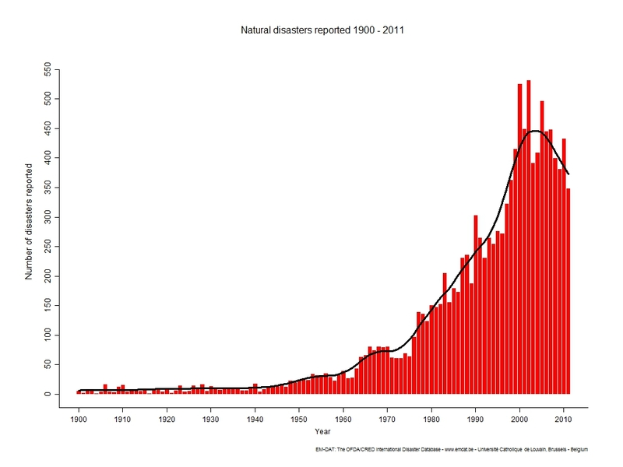
Number of disasters reported 1900-2011
The Facts
Natural Disasters Trend
* Sourse: Centre for Research on the Epidemiology of Disasters (CRED) -Emergency Events Database EM-DAT

Slide 3

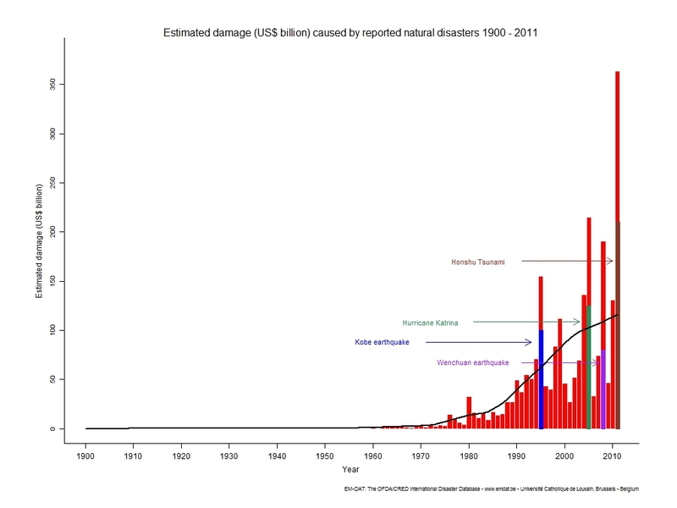
Estimated damages (US $ billion) caused by reported natural disasters 1900-2011
The Facts
Natural Disasters Trend
* Sourse: Centre for Research on the Epidemiology of Disasters (CRED) -Emergency Events Database EM-DAT

Slide 4
Global Trends
The Bad News: Number of reported natural disasters have been growing.
The Bad News: Number of people reported affected by natural disasters has been increasing.
The Bad News: Number of Estimated damages (in US $ billion) caused by reported natural disasters have been growing. Direct and indirect economic disaster losses have been increasing.
The Good News: Number of people reported killed by disasters has been decreasing. (Floods & Tropical Storms)

Slide 5
Why reducing disaster risk and building resilience?
Mo Hamza
14 May 2012
Mo Hamza
14 May 2012

Slide 6

Why disaster risk is increasing ?
Exposure
Concentration in hazardous locations or due to globalization
People
Assets
Economic Activities
Vulnerability
Poor building design
Poverty
Education
Low coping capacities
Hazards
Increase of
Frequency
Intensity
New/cascading
Increasing
Can either be reduced or increased by development
Cyclical/Climate change
Development can reduce vulnerability, but Development can also create disaster risk

Slide 7
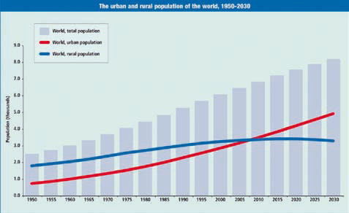
Rapid Global Urbanization
Explaining Observed Trends
The urban and rural population of the world. (Source: UN Population Division)

Slide 8
The Factors:
Explaining Observed Trends
Rapid Global Urbanization
More than 50% of the world’s population now lives in cities or urban areas, and this figure will likely rise to 70% in the next 50 years.
The United Nations expects 6.3 billion people or 68% of the world’s population to be living in urban areas by 2050.
Many of these cities are located on the coast and are threatened by floods, storms, earthquakes and other natural hazards.”
Source: Swiss Re, Mind the Risk: a global ranking of the cities under threat from natural disasters

Slide 9
Explaining Observed Trends
What are the main drivers explaining disaster risk tendencies ?
GAR 2009 refers to the “deadly (trio of) disaster risk drivers, made deadlier by climate change”:
Unplanned urban development
Vulnerable livelihoods
Ecosystem decline

Slide 10
Priorities for Action As learned from the HFA and emerging in HFA2
Mo Hamza
14 May 2012
Mo Hamza
14 May 2012

Slide 11
Priorities for Action (As learned from the HFA and emerging in HFA2)
Sustainable Development
Substantial reduction of disaster loses, in lives, in the social, economic and environmental assets of persons, communities and countries
Risk sensitive development
Prevent disaster risk creation and reduce the existing disaster risk through economic, social, cultural and environmental measures which address exposure and vulnerability and thus strengthen resilience
Understand disaster risk
Strengthen governance and institutions to manage disaster risk
Invest in economic, social, cultural and environmental resilience
Enhance preparedness for effective response and build back better in recovery and reconstruction

Slide 12
Conclusions
There is a need to:
Focus action on understanding risk and how it is created;
Strengthen governance mechanisms at all levels;
Invest in economic, social, cultural and environmental resilience; and
Enhance preparedness, response, recovery and reconstruction efforts at all levels.

Slide 13
Thank You!
Notes:
13

