Slide 1




Capacity Development for Making Cities Resilient
MODULE 3 The Local Government Self-Assessment Tool (LG-SAT)
Notes:
We have been talking about lack of local level progress attributing or reflecting in the national reporting or in the amcdrr outcomes. This third tier of HFA review is meant to fulfill that gap and help not only Local governments in identifying their status or gaps but also complementing the national hfa review process to be aware of the state of local implementation. However, this local government self assessment review should not be used only for HFA review rather in informing the long term development planning and highlighting the current state of DRR.

Slide 2

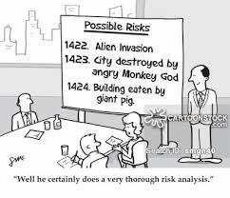
What is LG-SAT?

Slide 3

What is LG-SAT?
Local Government Self-Assessment Tool (LG-SAT)
Main Objectives of the Local Government Self-Assessment Tool (LG-SAT) is to:
Provide a self-assessment tool, methodology and a feedback mechanism for local and city governments to assess the status of achievements and understanding of existing gaps and challenges in disaster risk reduction at the local level.
Present a “baseline” and a status report for cities and local governments that have committed to the implementation of the Making Cities Resilient Campaign 10 Essentials.
Complement the national HFA monitoring and multi-stakeholder engagement process by providing information and an assessment of the situation from the local level.

Slide 4
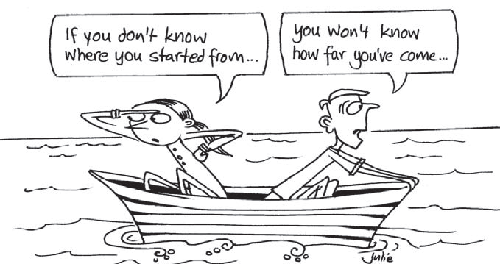
The Purpose of LG –SAT?
The idea is to allow cities to establish a baseline and a set of priorities for moving forward, probably over a period of years.
Alike the National process, the local HFA review is not a monitoring process of UNISDR.
The review process and participation of the local governments is purely voluntary in nature.

Slide 5
Who conducts the LG-SAT review?
Governments at local level
The local HFA review process is intended to be a multi-stakeholder review process led by the local governments at the local level.
The main actors of this multi- stakeholder local HFA review process are local government authorities, civil society organizations, community based organizations etc.
The involvement of civil society organizations and community based organizations is essential to the success of the review process and thus all local authorities are highly encouraged to ensure adequate participation of civil society and community based organizations in the consultations.

Slide 6
Proposed Element to Successfully Implement Multi-Steakholder Engagement Process
Identifying Relevant Participants. The most crucial element in review process is to get relevant actors involved.
Communicating the Objectives of the LG-SAT Process
Structuring the Consultation Process. Setting up groups of stakeholders for specific tasks (ex. around 5 HFA Priorities or MCR 10 Essentials)
Ensuring Active Participation and Contribution
Timing: Timing of the review process needs to be planned and communicated to all stakeholders.

Slide 7
5 Levels of Progress to Monitor Resilience at Local Level
Level | Generic Description of Achievement
5 | Comprehensive achievement has been attained, with the commitment and capacities to sustain efforts at all levels.
4 | Substantial achievement has been attained, but with some recognised deficiencies in commitment, financial resources or operational capacities.
3 | There is some commitment and capacities to achieving DRR but progress is not substantial.
2 | Achievements have been made but are relatively small or incomplete, and while improvements are planned, the commitment and capacities are limited.
1 | Achievements are minor and there are few signs of planning or forward action to improve the situation.

Slide 8
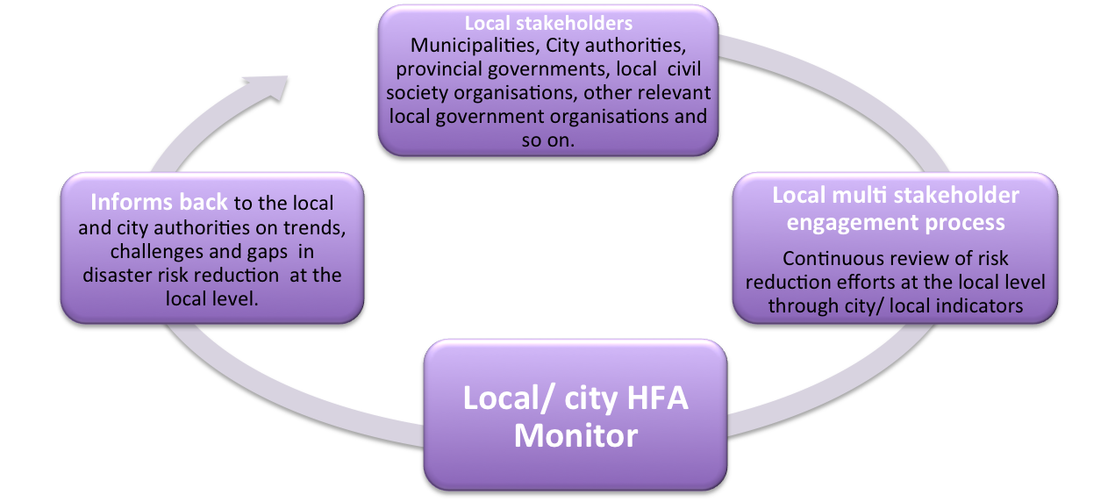
Local Feedback Loop
Local Government Self Assessment Tool (LG-SAT)
Notes:
The feedback process

Slide 9
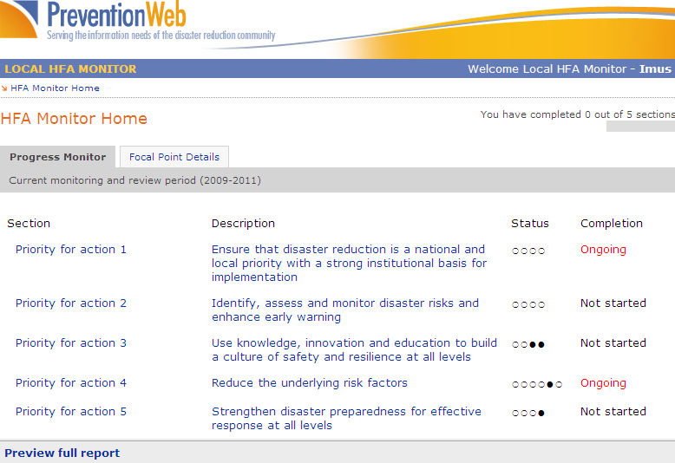
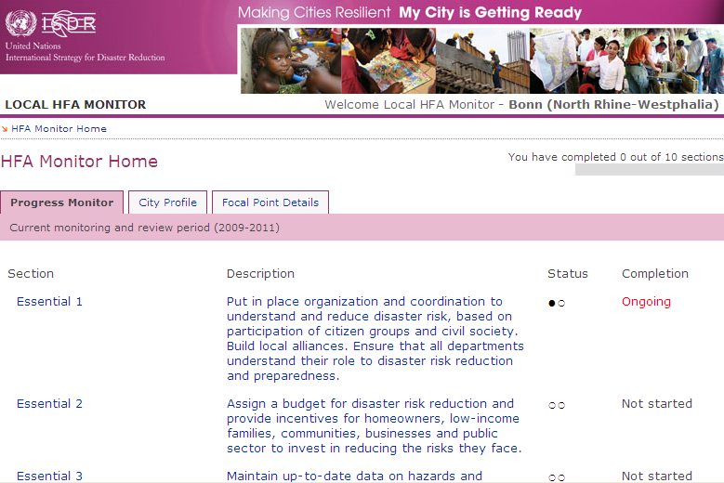
LG-SAT: LG/ City Indicators
5 level of progress per indicator /10 essentials
41 questions / indicators defined
Online tool available
You can choose on the dashboard (Sorting 41 Indicators either by HFA 5 Priority Areas, or Sorting by MCR 10 ESSENTIALS)
5 HFA priorities
Pilot countries: Nepal, Indonesia, Mozambique, Peru, Armenia
10 essentials:
Tested with participating cities
Notes:
Introduction
The UNISDR Secretariat has been assisting regional, national and local governments in monitoring and reviewing their status and progress in the implementation of the Hyogo Framework for Action (HFA) through a multi-tier progress monitoring and review process. The multi-tier monitoring framework is currently supporting the HFA review process at the national and regional level. This concept note outlines the proposed methodology of the third tier monitoring framework that focuses on the review process at the local level1 (i.e. municipalities, cities, provinces and so forth).
At the national level, a monitoring framework and a web-based system (the HFA Monitor 2 ) are available since 2008 to facilitate the monitoring of the HFA implementation. More than 100 countries have been carrying out HFA review processes with multi stakeholder engagement at the national level. A similar monitoring framework is available for regional inter-governmental organizations at the sub-regional level to facilitate the regional and sub-regional HFA review process.
In May 2010, the UNISDR secretariat and some key partners have also launched the Global Campaign “Making Cities Resilient – My City is Getting Ready!” The campaign will seek to convince city leaders and local governments to commit to a checklist of ”Ten Essentials”3 for Making Cities Resilient and to work alongside local activists, grassroots networks and national authorities.
Stakeholders: Who does the review process?
The local HFA review process is intended to be a multi-stakeholder review process led by the local governments4 at the local level. The main actors of this multi-stakeholder local HFA review process are local government authorities, civil society organizations, community based organizations and so forth. The involvement of civil society organizations and community based organizations is essential to the success of the review process and thus all local authorities are highly encouraged to ensure adequate participation of civil society and community based organizations in the consultations.
Mechanics: How will the review process work?
Local specific indicators: The local HFA review process will be carried out through a web based on-line system as well as a paper based template. The on-line system and the template is being developed by the UNISDR secretariat in consultation with relevant partners, including local government representatives, representatives of the Global NGO Network and other campaign partners.
The on-line local HFA monitor will be based on a set of local context specific indicators, in the shape of a questionnaire. In view of the diversified target audience ranging from city/municipality authorities to rural provincial authorities, the same set of local indicators has been aligned to both the HFA priority areas as well as to the Ten Essentials of the city campaign. Local indicators are therefore presented in the above two different formats, as illustrated in ANNEX I and II of this document.
On-line Local HFA monitor: The on-line system will be hosted on the www.preventionweb.net website and will be accessible to the participating local and city authorities. Access to the on-line system will be managed through a registration process facilitated by the UNISDR regional offices. Each user will be provided a unique User ID and Password to access the system. The indicators/questions will be presented in both the formats (aligned to HFA priorities and to the Campaign Ten Essentials) and will be available on-line as well as off-line. All inputs from the Local HFA review process will feed in to the national and regional HFA monitoring process.
Feedback through pilot process: The Local HFA monitoring and review process will be rolled out by December 2010 for all local authorities globally. However, in order to demonstrate the complementarity between the local, national and city monitoring process, UNISDR in partnership with DG ECHO and the Global Network of Civil Societies for Disaster Risk Reduction will actively support the process in five pilot countries (i.e. Armenia, Indonesia, Mozambique, Nepal and Peru). The main aim of the pilot initiative will be to facilitate the multi-stakeholder engagement process involving local authorities, civil society organisations and the national government;
and to draw lessons and gather feedback on the indicators, tools and methodology at the same time.

Slide 10
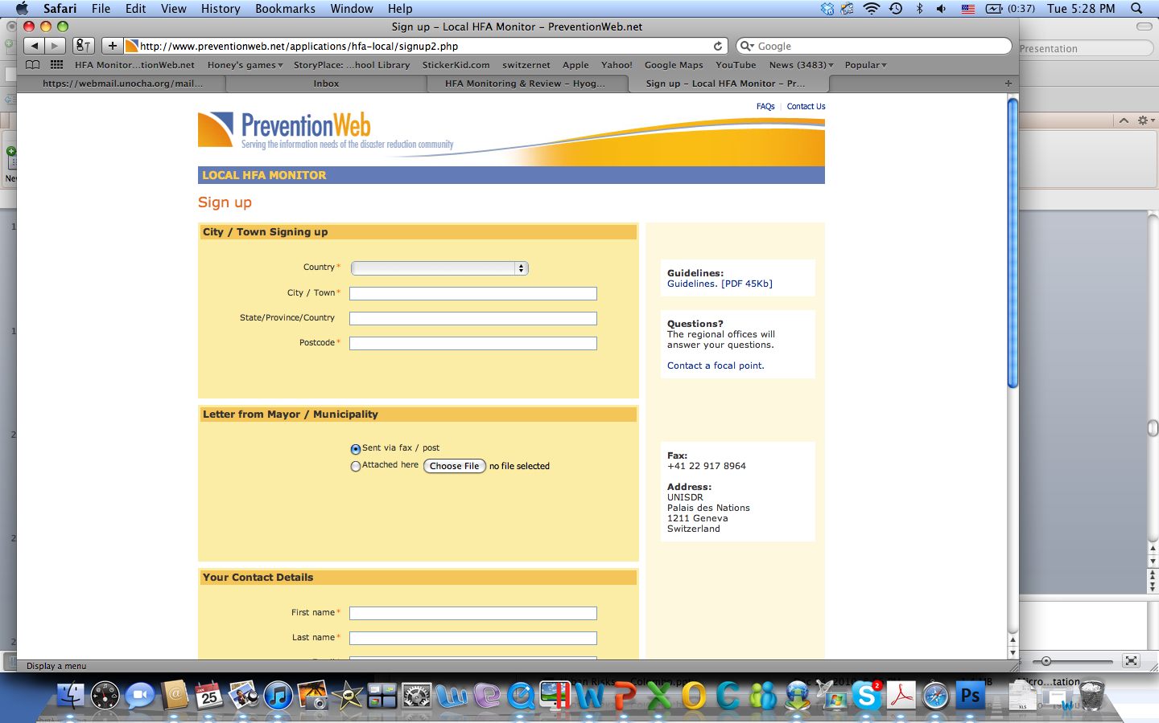

Slide 11
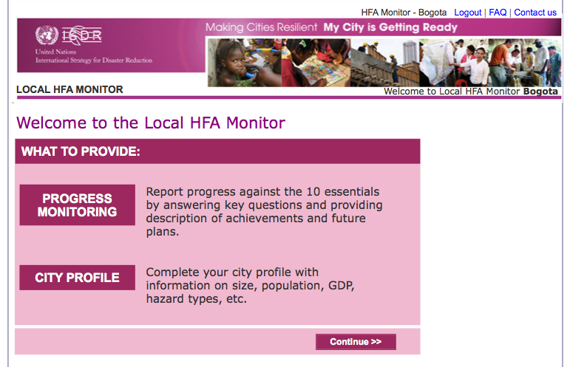

Slide 12
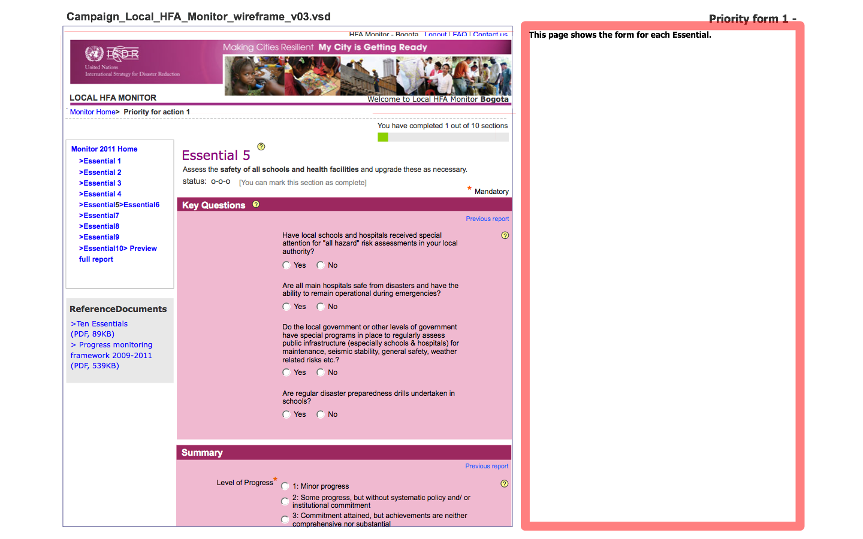

Slide 13
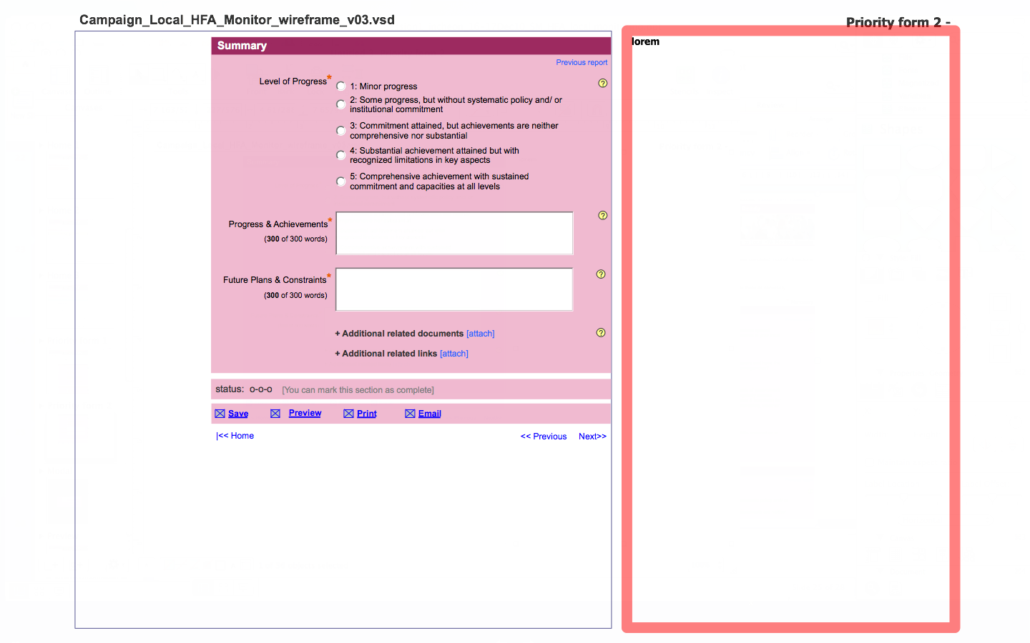

Slide 14
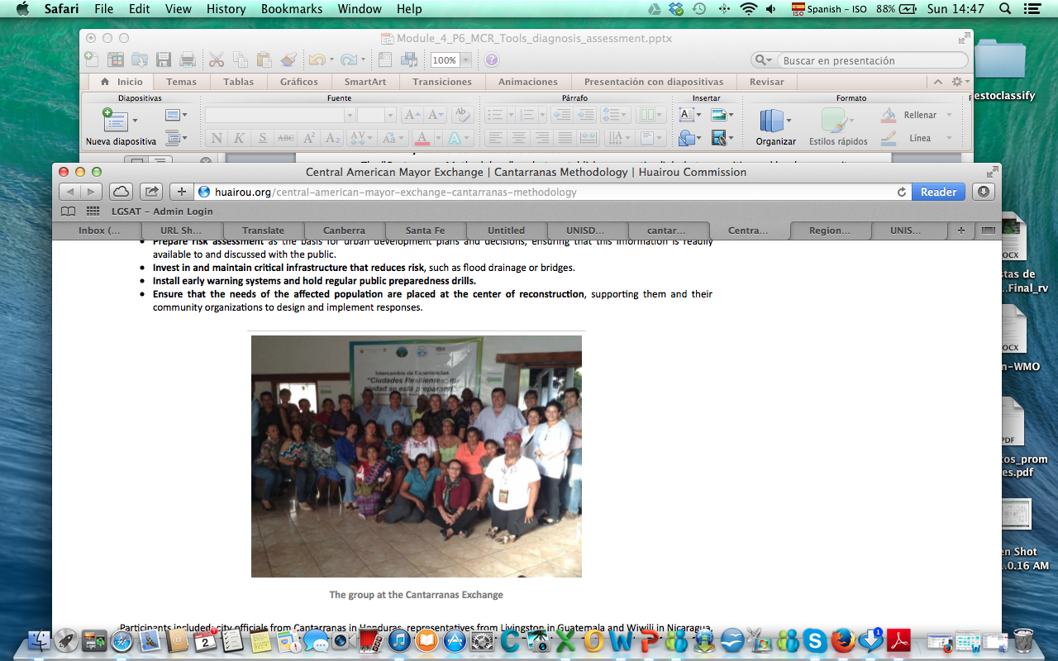
Case Study
The “Cantarranas” Methodology-Honduras
Mayors and leaders of Resilient Cities of Central America (Cantarranas, Honduras; Livingston, Guatemala; and Wiwili, Nicaragua) came together in the Municipality of Cantarranas, Honduras, on August 06-07,2013. There, they carried out an exchange of experiences of the between the mayors, which were certified through the "Cantarranas Methodology."
City officials, grassroots women's groups, and other key actors came together to create an intervention strategy to implement the MCR 10 Essentials and generate key ideas for the formulation of work/action plans in each of the cities:
As part of the exercise they have stressed the importance of conducting risk assessment using LG-SAT as the basis for urban development plans and decisions, and ensuring that this information is readily available to and discussed with the public.
For more information about this case study illustrating the use of the LGSAT/Local HFA by local civil society organizations to promote the integration of disaster risk reduction in the development process visit http://archive.constantcontact.com/fs151/1101426922527/archive/1115386651838.html

Slide 15

LG-SAT Exercise Working Groups Discussions Points
Divide into 3-4 groups.
Use the LG-SAT Offline Form and LG-SAT Assessment Report Template to conduct assessment using your own city as an example. Discuss in your group and provide answers to the questions/indicators under each of 10 Essentials. Your Assessment Report should include:
An assessment/ranking of the situation for each indicator/question under each essential on a scale of 1 to 5, (where 1 is minor achievements and 5 is comprehensive achievements made) Summarizing the findings for each key question.
A short description of the main issues, gaps and challenges identified for each LG-SAT question/indicator under each of 10 Essentials that have rated low as 1, 2 or 3. (Those questions that you have rated low as 3 or less (ex. 2, 1) please frame as issues to be addressed, under the DESCRIPTION Section of the provided LG-SAT Report Template).
A description of issues identified, which are not included in the 10 essentials, regarded as relevant to understand/improve the disaster risk management situation in the study area (90 min)
Present findings of your group discussions to other participants of the Session (30 min)
Duration of this Group Work Exercise is 120 min.

Slide 16
Thank you!

