Slide 1




Sectoral Programs for Socio-Economic Development
Mo Hamza
14 May 2012
Mo Hamza
14 May 2012

Slide 2

Essential 10
LIVELIHOODS

Slide 3
Enabling Livelihood
Protection

Slide 4
Issue : Protecting and replacing productive assets
    Establishing Assets to generate Income
    Without an income, individuals and households are obliged to rely on friends, family, and available assistance to meet their most basic needs of food and shelter.
    Prevent assets depletion
    Since assets may not be immediately available, continued livelihood provisioning may be necessary to prevent asset depletion.
    To address the asset needs of affected populations, recovery actors have developed and applied a range of different approaches include: cash grants, in-kind assistance, and temporary employment.

Slide 5
Case: Village livelihood grants in China
This program was started on March 6, 2009, involving over 30 villagers in Mingyue Village at Anxian of Sichuan. Challenge: Rebuilding their homes was costly, most of their money was gone and they were having difficulty resuming agricultural activities
By placing the communities at the center of identifying needs and designing and implementing potential solutions, the initiative benefits from their intimate knowledge of available assets, local market opportunities, and viable livelihood strategies.
By establishing working relationships with local experts, the women may still have access to technical support once the project has terminated

Slide 6
Linking Cash Based Program with Financial Institutions
Kenya, as part of the Hunger Safety Net Programme (HSNP), cash is delivered using a smart card system. Recipients have their fingerprints scanned and receive a smart card that they take to a local trader or agent to get their cash. The local trader or agent uses a Point of Sale device to verify recipients’ identities. People are also able to get their cash from a branch of Equity Bank. In urban slum areas of Kenya, in response to food price increases and post-election violence, Concern and Oxfam in conjunction with the government of Kenya are using mobile phones to transfer cash. Recipients are provided with a SIM card (and sometimes a mobile phone, if they do not have one), and they can retrieve the cash at any participating M-PESA/Safaricom agent.
Source: http://www.savethechildren.org.uk/en/docs/Delivering_Money_low_res.pdf

Slide 7

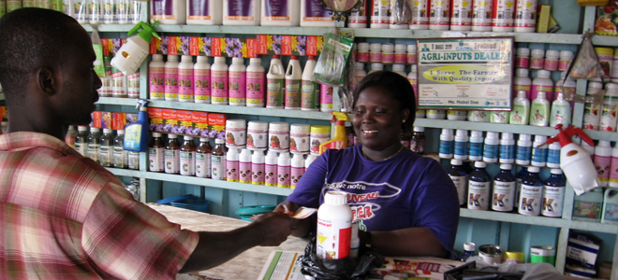

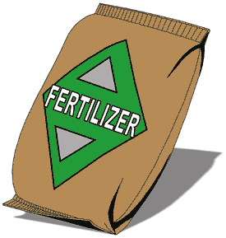
Flexi-Voucher Malawi
Delivering Agricultural Vouchers
The vouchers can be exchanges for seeds, fertilizers and farming tools
Utilize Local Stores for Delivering
Utilization of local retail outlets for distribution instead of distribution of pre-packaged inputs increases availability of desired.
Livelihood Impacts
Households had more freedom in the selection of goods, increasing of livelihood recovery options.
Better access of seeds and fertilizers in local level.
Utilization of local retail benefited local market and directly assisted the livelihoods within community
Seeds
Farming Tools
http://crs.org/kenya/finding-peace-post-conflict/

Slide 8
Case: Uncoordinated provision of fishing boats
Assistance to replace damaged boats has been forthcoming from many donors and the number of boats is already close to pre-tsunami levels
The uncoordinated replacement of fishing vessels in some locations has resulted in a larger number of smaller vessels than before the tsunami, potentially leading to overfishing
→ Drawback of material assistance
Without actively engaging the fishermen in determining the design requirements, assistance providers failed to recognize the complex effects on the marine ecosystem and the local economy
It is extremely important to have consultations at the village and community levels to identify the real needs and the best ways to meet those needs.

Slide 9
Recommended Public Work Employment Scheme Donnges, 2009 (ADB)
Construction of large dams and irrigation structures (including lining of canals); Construction and maintenance of ports, railways and airport runways, and dredging channels. | Agricultural terracing and land development, and cleaning irrigation cannels, fish pond development; and water and soil conservation, flood protection, river training and drainage works, irrigation works.
Low-volume unsealed roads (construction and maintenance) and high-volume roads (maintenance); | Rehabilitation and maintenance of public offices, parks, playing fields, parking areas, etc;
Water and sanitation, electrification and telecommunication (trenches for laying pipe and cable) | Construction and maintenance of markets, workshops and other economic infrastructure;
Social infrastructure (construction and maintenance of schools, clinics); Construction of sanitation systems; | Construction of primary and secondary roads and bridges;

Slide 10
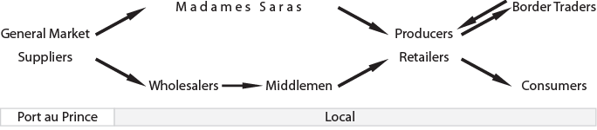
Case: Improving relevancy of livelihood interventions through market analysis in Haiti
Condition Post Floods and Landslides
Lost Pack Animal for transports and stock
Unaffected
Purchasing power reduced
Transport and Storage Facility Destroyed
Left with debt to pay
Lost Pack Animal for transports and stock

Slide 11
Case: Improving relevancy of livelihood interventions through market analysis in Haiti
Interventions
Strengthening and preparing farmer for the next season crops, ensuring available stock for customers
Cash Voucher to rebuild business
Farmer
Improving Purchasing Power through
CFW
Wealthy community, no need for assistance
Cash Voucher to rebuild business
Rehabilitation Infrastructure connected to local market

Slide 12
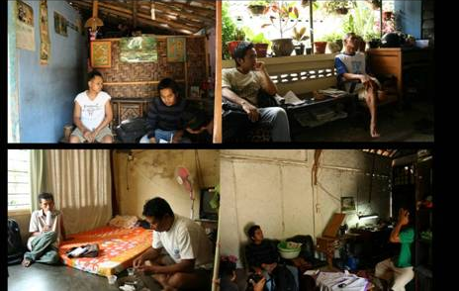






Case: Engaging Universities and the Private Sector in Yogyakarta
Preliminary Survey for targeting the beneficiaries collaborated with Heritage District Management Organization
The Designs
University Visit to affected Crafters
Website:
http://kotagedecrafts.multiply.com/
Exhibition TexCraft 2008

Slide 13
Case: Tailoring Loans for Farmers in Bangladesh, 2005
The International Fund for Agricultural Development (IFAD) and the Government of Bangladesh joined forces with the Palli Karma-Sahayak Foundation (PKSF), provided credit to farming communities through local NGOs, the project has introduced flexible financial services that meet the needs of smallholder farmers while solving problems encountered by microfinance projects in the past. Innovations include:
extending the grace period before repayment starts
extending the period between payments from weekly to fortnightly, monthly or even quarterly
requiring regular payments only of service charges during the first part of the loan period
offering seasonal loans with lump-sum repayment after harvest

Slide 14
Case: New market for traditional livelihoods in Sri Lanka
The 2004 tsunami hit the industry coconut and coir industry hard, wiping out coconut palm trees, spinning equipment, coir mills, and soaking pits. Oxfam intervened immediately to help the women restore their incomes by:
Collaboration with National Institute of Business Management carried out a market chain analysis to learn how the spinners could eventually increase their profits.
The research proposed women learn to manufacture value-added products like doormats, brooms, and planters, which they could sell at higher prices than simple twine, creating a worker-controlled company that would represent the interests of village-level coir spinners and improve their leverage in the marketplace.
The Oxfam following up the research by providing training on how to create value-added products and run small businesses, and developing and distributing mechanized equipment to help the women boost their production and ensure greater consistency in their products
Partnering with business and economic experts can help to expose new viable markets for traditional livelihoods.

Slide 15
Case: Creating commodity associations in Zimbabwe
Challenge: lack of knowledge about markets has worked to the middle-person's advantage to offer ready cash at half the market price to the desperate and unsuspecting farmer - only to sell the commodity at double the price.
Commodity associations are platforms where farmers share knowledge on the use of appropriate and affordable technologies aimed at increasing their agricultural produce.
Built the capacity of small-scale producer communities to use commodity associations when lobbying/demanding for increase of support from service delivery institutions such as the Zimbabwe Farmers' Union (ZFU).
Developing the organizational and institutional capacity of individuals sharing similar livelihoods can create a community of practice in which each member enhances their own knowledge and capabilities through the shared experience of others.
By working as a collective, individuals increase their political capital, enabling them to better advocate for changes that make their livelihoods more sustainable

