Slide 1




Essential 2 Sectoral Programmes Financing DRR
Mo Hamza
14 May 2012
Mo Hamza
14 May 2012

Slide 2

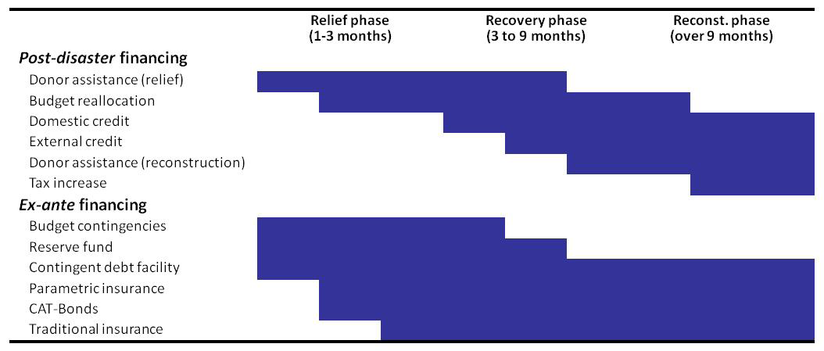
Figure: Source of financing

Slide 3
The Cost of Financial Instrument
Obviously, grant financing from donors will always be the cheapest source of financing post disaster. Many donors have well‐established humanitarian programs and can be quick to respond, particularly to support relief operations. Unfortunately, donor financing is plagued with limitations.
1. It is often driven by media coverage, making donor assistance difficult to predict. For example, the catastrophic floods in Guyana in 2005 occurred just a few weeks after the major earthquake in Pakistan in October 2005, and had very limited media coverage resulting in limited international assistance.
2. Mobilizing such funds is a complex process that can take months to complete.
3. Donor funding after an event sometimes comes at the expense of pre‐established program and thus implies an opportunity cost.
4. With limited resources, donors are rarely able to support larger reconstruction programs.

Slide 4
The cost of financial instrument
Governments’ own reserves, budget contingencies, budget reallocations and emergency loans are the most common sources of post‐disaster financing. Unfortunately, all also have limitations.
1. Budget contingencies usually represent about 2 to 5 percent of government expenditures (such as in Vietnam, Indonesia or Colombia) and are not earmarked only for natural disasters. Vietnam, for example, has experienced several cases where a major cyclone hit the country in November, when the contingency budget had already been fully exhausted.
2. Systematic use of budget reallocations endangers development programs that have often required years of preparation.
3. Emergency loans may take a long time to negotiate and do not allow for immediate resource mobilization.
Governments have recently taken a closer look at instruments available in the financial markets such as traditional insurance, parametric insurance and ART mechanisms (CAT‐Bonds in particular). Traditional insurance is already in use in many countries to insure public and private assets.

Slide 5
Box 1. Reducing the moral Hazard of post‐disaster assistance
Nevertheless, the use of insurance and ART remains a relatively expensive proposition for governments.
The Development Policy Loan (DPL) with Catastrophe Risk Deferred Drawdown Option, DPL with CAT DDO, is a financial instrument that offers IBRD‐eligible countries immediate liquidity of up to USD$500 million or 0.25 percent of GDP (whichever is less) in case of a natural disaster. The instrument was designed by the World Bank to provide affected countries with bridge financing while other sources of funding are being mobilized.
The CAT DDO was created to encourage investment in risk reduction. Indeed, to have access to this contingent credit, countries must show that they have engaged in a comprehensive disaster management program.
As such, the DPL with CAT DDO is the first financial instrument offered by the donor community that aims at addressing the problem of moral hazard in donor funding for disaster recovery.

Slide 6
Bringing it all together

Slide 7
Combining Financial Instruments
How does it all come together and how can we combine the various instruments in an efficient and effective financial protection strategy for governments?
Catastrophe risk layering can be used to design a risk financing strategy (see Figure). Budget contingencies together with reserves are the cheapest source of ex‐ante risk financing and will generally be used to cover the recurrent losses. Other sources of financing such as contingent credit, emergency loans and possibly insurance should enter into play only once reserves and budget contingencies are exhausted or cannot be accessed fast enough.
A “bottom‐up” approach is recommended: the government first secures funds for recurrent disaster events and then increases its post‐disaster financial capacity to finance less frequent but more severe events.
The sequence is:
The need for immediate liquidity to ensure that relief and recovery are not delayed.
The need to mobilize sufficient resources for reconstruction.
Amounts needed for reconstruction generally dwarf liquidity needs but are not bound by the same time constraints.

Slide 8
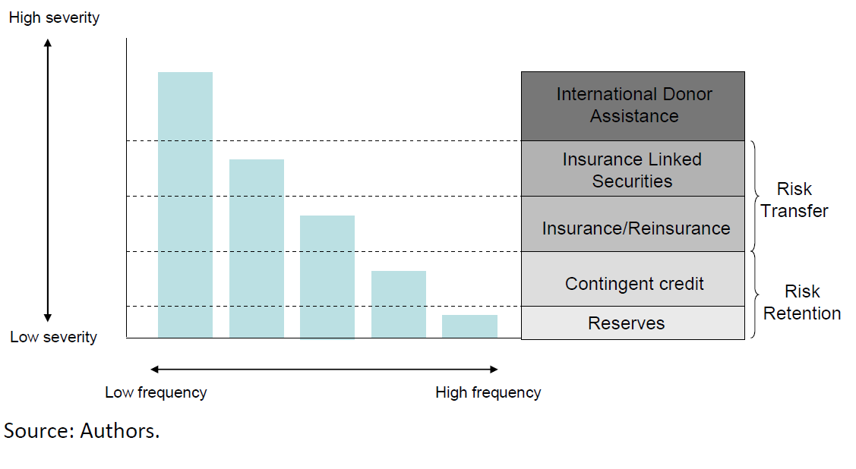
Figure: Catastrophe risk layering

Slide 9
Box: Reducing the moral Hazard of post‐disaster assistance
The World Bank assisted CARICOM in establishing the Caribbean Catastrophe Risk Insurance Facility (CCRIF), a joint reserve facility that offers liquidity coverage, akin to insurance, to 16 Caribbean Countries exposed to earthquakes and hurricanes.
The CCRIF was capitalized with support from participating countries and donor partners.
The Facility became operational on June 1, 2007, and can count on its own reserves of over US$90 million and reinsurance of US$110 million. This provides the Facility with US$200 million of risk capital. After the 7.4 earthquake in late 2007, the Saint Lucian and Dominican governments received CCRIF’s first payouts; US$0.9 billion to finance urgent post-earthquake recovery efforts. In early 2010 Haiti government received the full policy amount of US$8 million.
Drawing on the lessons of the CCRIF, the Pacific island states are exploring the creation of the Pacific Disaster Reserve Fund.

Slide 10
Box: Catastrophe bonds
CAT bonds are a class of assets known as event‐linked bonds, which trigger payments on the occurrence of a specified event. Most event‐linked bonds have been linked to catastrophes such as hurricanes and earthquakes, although bonds also have been issued that respond to mortality events.
Capital raised by issuing the bond is invested in safe securities such as Treasury bonds, which are held by a special purpose vehicle (SPV). The bond issuer holds a call option on the principal in the SPV with triggers spelled out in a bond contract. Those can be expressed in terms of the issuer’s losses from a predefined catastrophic event, by hazard event characteristics, or by hazard event location. If the defined catastrophic event occurs, the bond issuer can withdraw funds from the SPV to pay claims, and part or all of interest and principal payments are forgiven. If the defined catastrophic event does not occur, the investors receive their principal plus interest. The typical maturity of CAT bonds is 1–5 years, with an average maturity of 3 years.

Slide 11
Community-driven disaster risk reduction in Philippine cities
Organized urban communities are strong vehicles for social mobilization and disaster risk reduction in the Philippines. Communities are involved in the identification and prioritization of post-disaster assistance, and in the management of materials for housing.
The community associations also used their own savings as leverage to engage municipal government in obtaining additional resources to secure land for post-disaster housing. Municipalities can access national calamity funds, as well as local calamity funds, which can be 5 percent of their total budget.
The new Disaster Risk Reduction and Management Law of 2010 enables such funds to be used for disaster risk reduction, with a need to reserve only 30 percent as a contingency for post-disaster interventions.

Slide 12
Mainstreaming DRR into the budget
Peru was the first country to include disaster risk into its evaluation criteria for public investment projects, followed by Costa Rica and Guatemala. In Peru, it is now a legal requirement that all public investment projects be evaluated for disaster risks. If the risks are not addressed, the project is not financed. In Peru, the National System for Public Investment was created in 2000, and disaster risk was formally incorporated by 2007.
This was achieved by developing risk concepts and assessment methods, convening a large number of actors from different levels of government and across departments, training more than 900 professionals, implementing new standards and instruments, and developing a long-term vision of investment.
(GAR 2011)

Slide 13
Recent experience using
Traditional Property
Catastrophe Insurance

Slide 14
Combining Financial Instruments
The establishment of the Turkish Catastrophe Insurance Pool (TCIP) helped the Government of Turkey reduce its contingent liability by promoting domestic property catastrophe insurance for private dwellings.
Making it possible for homeowners to purchase insurance, the Government of Turkey has increased the number of citizens who would be compensated by the private sector in case of an earthquake.
In addition, by making insurance compulsory for middle‐ and high‐income urban households, the Government of Turkey has significantly reduced the number of homeowners likely to require financial assistance after a disaster.

Slide 15
The Turkish Catastrophe Insurance Program
The Turkish Catastrophe Insurance Pool, TCIP, was established in the aftermath of the Marmara earthquake in 2000, with assistance from the World Bank. Traditionally, Turkey’s private insurance market was unable to provide adequate capacity for catastrophe property insurance against earthquake risk, and the Government of Turkey faced major financial exposure in the post‐disaster reconstruction of private property. Consequently, the Government of Turkey’s objectives for TCIP were to:
Ensure that all property tax‐paying dwellings have earthquake insurance cover;
Reduce government fiscal exposure to the impact of earthquakes;
Transfer catastrophe risk to the international reinsurance market;
Encourage physical risk mitigation through insurance.

Slide 16
The Turkish Catastrophe Insurance Program
TCIP was established in 2000 as a public sector insurance company, managed on sound technical and commercial insurance principles. The company’s initial capital was supplemented by a World Bank contingent loan. TCIP purchases commercial reinsurance and the Government of Turkey acts as a catastrophe reinsurer of last resort for claims arising out of an earthquake with a return period of greater than 300 years.
The TCIP Policy was designed as a stand‐alone property earthquake policy with a maximum sum insured per policy of US$65,000 and an average yearly premium of US$46. Premium rates are based on the construction type (two types are possible) and property location (five earthquake risk zones were identified) and vary from less than 0.05% for a concrete reinforced house in a low risk zone to 0.60% for a house located in the highest risk zone.
The policy is distributed by about thirty existing Turkish insurance companies, which receive a commission. The government invested heavily in insurance awareness campaigns and made earthquake insurance compulsory for home‐owners in urban areas.
Cover is voluntary for homeowners in rural areas.

Slide 17

Thank You!

