Slide 1




Essential 4
Sectoral Programmes
Mainstreaming DRR and CCA into Critical Facilities and Infrastructure

Slide 2

Case Study
climate data
Filters
Second stage screening:
Purposes:
Relevant to project category
Components:
Suitable for project scope
Manages risks to the project
Lead stakeholders involved
Activities:
Affordable, benefits justify costs
Institutional competence for implementation
Intended beneficiaries are major focus
Selection filters
AREP
AREP
Answers
Manage climate risk by improved design of key project assets
Assist local communities
Adjust design of new assets to increase climate resilience
Increase resilience of infrastructure and building used by local communities
Increase roadside drainage capacity/bridge spans/culvert dims/bridge strength
Investigate alternative road surface composition to cope with higher temperature
Ensure new community buildings consider climate risk in their design
Selection filters
climate resilient project
$ approved
PCN approved

Slide 3
Financial Incentives
Northridge Earthquake, California, USA, 1994
The earthquake forced closure of four major highway corridors that carried over 780,000 vehicles per day, including commuters as well as freight. The city placed priority on the replacement and restoration of highway infrastructure in order to ensure economic recovery.
To expedite the completion of highway rebuilding projects, the California Department of Transportation (CalTrans) included financial incentives in its contracts. Under this approach, bonuses were available to each contractor who completed projects early.
CalTrans calculated bonuses based on analysis of economic cost incurred to the region as a result of the disruption to traffic and associated delays. These incentives allowed the city to restore freeways within a few months.
Prioritization of transportation infrastructure may be required to protect economic drivers
Investment in financial incentives for rapid completion of infrastructure contracts can help
Notes:
3

Slide 4
Upgrading technology
Maldives
2005
The Government of the Maldives introduced a number of strategies through which communications may be better maintained in emergencies in future events -
Increased Use of Satellite-Based Handheld Phones. To have one satellite phone in each of the inhabited islands.
HF radio transceivers.
CB radio transceivers.
VSAT.
Optical Fiber.
Improvements in telecommunications infrastructure can help link previously isolated regions
Vulnerable infrastructure nodes puts the entire infrastructure network at risk; as such, DRR efforts must place special care in ensuring that these vulnerabilities are addressed in planning
The speed with which communication technology advances mandates that technological advancements be applied frequently
Notes:
4

Slide 5
Infrastructure: Vision for Lower Manhattan
“Companies come here because the people they want to employ want to live here…Cultural institutions, great parks, clean streets, safe streets – those are the things that get the work force here.”
The mayor agreed, but he and many others felt that these trends were being ignored in the rush to rebuild a commercial development of 10 million square feet of office space predicated on the lease between Silverstein and the Port Authority.
“But no matter how magnificent the best design for the 16 acres of the World Trade Center site proves to be, it must be complemented by an equally bold vision for all of Lower Manhattan …that meets the needs of all of New York City and of the entire region.
Notes:
5

Slide 6
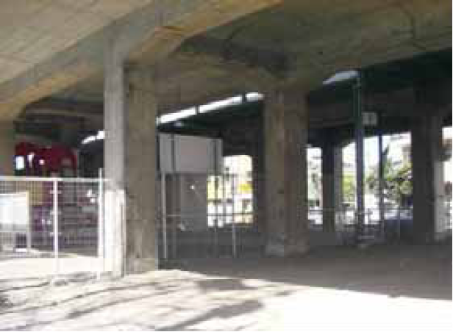
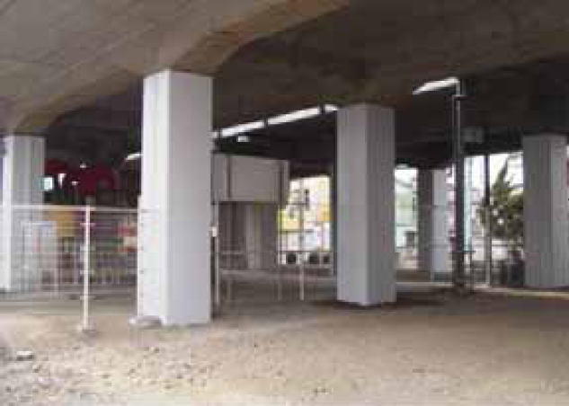
Reinforcement of Tohoku Shinkansen (bullet train)
Elevated tracks and bridges reinforced twice after the Great Hanshin-Awaji Earthquake 1995 and the Sanriku Minami Earthquake 2003
No significant damage to main structures → Early resumption of the train service

Slide 7
Pooling of technical staff
The Caribbean Electric Utility Services Corporation (CARILEC) provides services to members including the CARILEC Hurricane Action Plan (CHAP). CARILEC created CHAP to provide for the assembly, dispatch and coordination of emergency teams of linesmen from member utilities.
Their role is to help restore electric transmission and distribution systems in a country affected by a serious hurricane. To be eligible for assistance and training under the program, each utility pays an annual fee of US$2,000 to the Hurricane Fund. After Hurricane Ivan, Grenlec requested assistance through the CHAP, which deployed 100 linesmen from the region to help repair and restoration of Grenlec’s operations.
Trained infrastructure utility experts can be inventoried prior to a disaster – through regional cooperation
Notes:
7

Slide 8
Funding Infrastructure
Insurance
Government-based emergency relief funds
Donations
Loans (including the reprogramming of existing development loans)
Catastrophic bonds and weather derivatives
Private development funding
Development Incentives
Tax increases
Remittances

Slide 9
Thank you

