Slide 1




Sectoral Programs for Socio-Economic Development
Mo Hamza
14 May 2012
Mo Hamza
14 May 2012

Slide 2

Essential 10
LIVELIHOODS

Slide 3
Enabling Livelihood
Protection

Slide 4
Issue : Protecting and replacing productive assets
    Establishing Assets to generate Income
    Without an income, individuals and households are obliged to rely on friends, family, and available assistance to meet their most basic needs of food and shelter.
    Prevent assets depletion
    Since assets may not be immediately available, continued livelihood provisioning may be necessary to prevent asset depletion.
    To address the asset needs of affected populations, recovery actors have developed and applied a range of different approaches include: cash grants, in-kind assistance, and temporary employment.

Slide 5
Case: Village livelihood grants in China
This program was started on March 6, 2009, involving over 30 villagers in Mingyue Village at Anxian of Sichuan. Challenge: Rebuilding their homes was costly, most of their money was gone and they were having difficulty resuming agricultural activities
By placing the communities at the center of identifying needs and designing and implementing potential solutions, the initiative benefits from their intimate knowledge of available assets, local market opportunities, and viable livelihood strategies.
By establishing working relationships with local experts, the women may still have access to technical support once the project has terminated

Slide 6
Linking Cash Based Program with Financial Institutions
Kenya, as part of the Hunger Safety Net Programme (HSNP), cash is delivered using a smart card system. Recipients have their fingerprints scanned and receive a smart card that they take to a local trader or agent to get their cash. The local trader or agent uses a Point of Sale device to verify recipients’ identities. People are also able to get their cash from a branch of Equity Bank. In urban slum areas of Kenya, in response to food price increases and post-election violence, Concern and Oxfam in conjunction with the government of Kenya are using mobile phones to transfer cash. Recipients are provided with a SIM card (and sometimes a mobile phone, if they do not have one), and they can retrieve the cash at any participating M-PESA/Safaricom agent.
Source: http://www.savethechildren.org.uk/en/docs/Delivering_Money_low_res.pdf

Slide 7
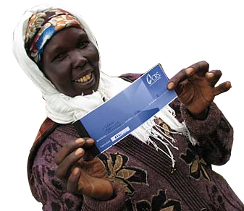
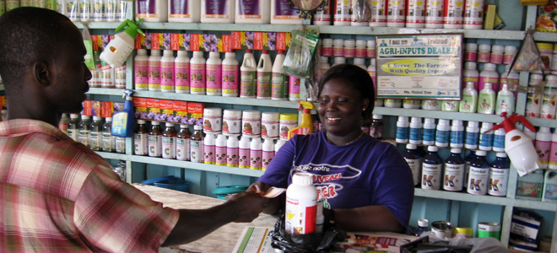

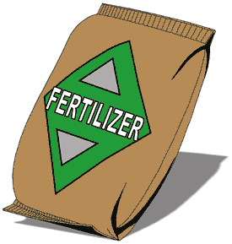
Flexi-Voucher Malawi
Delivering Agricultural Vouchers
The vouchers can be exchanges for seeds, fertilizers and farming tools
Utilize Local Stores for Delivering
Utilization of local retail outlets for distribution instead of distribution of pre-packaged inputs increases availability of desired.
Livelihood Impacts
Households had more freedom in the selection of goods, increasing of livelihood recovery options.
Better access of seeds and fertilizers in local level.
Utilization of local retail benefited local market and directly assisted the livelihoods within community
Seeds
Farming Tools
http://crs.org/kenya/finding-peace-post-conflict/

Slide 8
Case: Uncoordinated provision of fishing boats
Assistance to replace damaged boats has been forthcoming from many donors and the number of boats is already close to pre-tsunami levels
The uncoordinated replacement of fishing vessels in some locations has resulted in a larger number of smaller vessels than before the tsunami, potentially leading to overfishing
→ Drawback of material assistance
Without actively engaging the fishermen in determining the design requirements, assistance providers failed to recognize the complex effects on the marine ecosystem and the local economy
It is extremely important to have consultations at the village and community levels to identify the real needs and the best ways to meet those needs.

Slide 9
Recommended Public Work Employment Scheme Donnges, 2009 (ADB)
Construction of large dams and irrigation structures (including lining of canals); Construction and maintenance of ports, railways and airport runways, and dredging channels. | Agricultural terracing and land development, and cleaning irrigation cannels, fish pond development; and water and soil conservation, flood protection, river training and drainage works, irrigation works.
Low-volume unsealed roads (construction and maintenance) and high-volume roads (maintenance); | Rehabilitation and maintenance of public offices, parks, playing fields, parking areas, etc;
Water and sanitation, electrification and telecommunication (trenches for laying pipe and cable) | Construction and maintenance of markets, workshops and other economic infrastructure;
Social infrastructure (construction and maintenance of schools, clinics); Construction of sanitation systems; | Construction of primary and secondary roads and bridges;

Slide 10
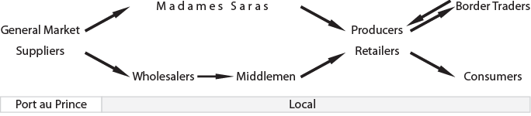
Case: Improving relevancy of livelihood interventions through market analysis in Haiti
Condition Post Floods and Landslides
Lost Pack Animal for transports and stock
Unaffected
Purchasing power reduced
Transport and Storage Facility Destroyed
Left with debt to pay
Lost Pack Animal for transports and stock

Slide 11
Case: Improving relevancy of livelihood interventions through market analysis in Haiti
Interventions
Strengthening and preparing farmer for the next season crops, ensuring available stock for customers
Cash Voucher to rebuild business
Farmer
Improving Purchasing Power through
CFW
Wealthy community, no need for assistance
Cash Voucher to rebuild business
Rehabilitation Infrastructure connected to local market

Slide 12
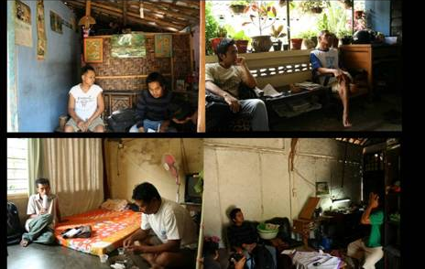





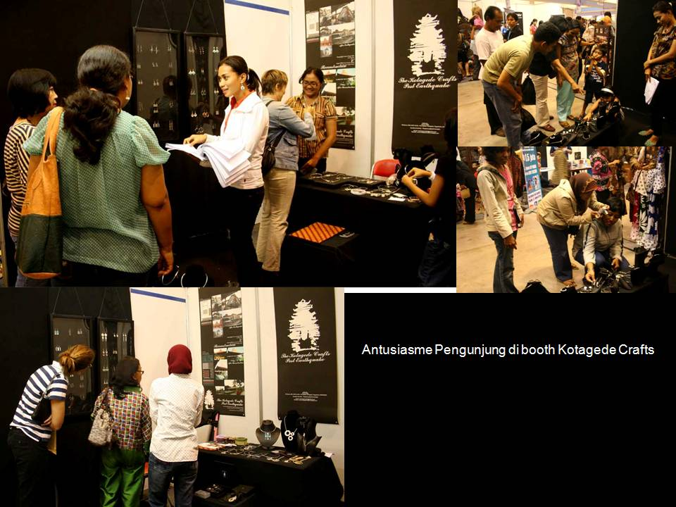
Case: Engaging Universities and the Private Sector in Yogyakarta
Preliminary Survey for targeting the beneficiaries collaborated with Heritage District Management Organization
The Designs
University Visit to affected Crafters
Website:
http://kotagedecrafts.multiply.com/
Exhibition TexCraft 2008

Slide 13
Case: Tailoring Loans for Farmers in Bangladesh, 2005
The International Fund for Agricultural Development (IFAD) and the Government of Bangladesh joined forces with the Palli Karma-Sahayak Foundation (PKSF), provided credit to farming communities through local NGOs, the project has introduced flexible financial services that meet the needs of smallholder farmers while solving problems encountered by microfinance projects in the past. Innovations include:
extending the grace period before repayment starts
extending the period between payments from weekly to fortnightly, monthly or even quarterly
requiring regular payments only of service charges during the first part of the loan period
offering seasonal loans with lump-sum repayment after harvest

Slide 14
Case: New market for traditional livelihoods in Sri Lanka
The 2004 tsunami hit the industry coconut and coir industry hard, wiping out coconut palm trees, spinning equipment, coir mills, and soaking pits. Oxfam intervened immediately to help the women restore their incomes by:
Collaboration with National Institute of Business Management carried out a market chain analysis to learn how the spinners could eventually increase their profits.
The research proposed women learn to manufacture value-added products like doormats, brooms, and planters, which they could sell at higher prices than simple twine, creating a worker-controlled company that would represent the interests of village-level coir spinners and improve their leverage in the marketplace.
The Oxfam following up the research by providing training on how to create value-added products and run small businesses, and developing and distributing mechanized equipment to help the women boost their production and ensure greater consistency in their products
Partnering with business and economic experts can help to expose new viable markets for traditional livelihoods.

Slide 15
Case: Creating commodity associations in Zimbabwe
Challenge: lack of knowledge about markets has worked to the middle-person's advantage to offer ready cash at half the market price to the desperate and unsuspecting farmer - only to sell the commodity at double the price.
Commodity associations are platforms where farmers share knowledge on the use of appropriate and affordable technologies aimed at increasing their agricultural produce.
Built the capacity of small-scale producer communities to use commodity associations when lobbying/demanding for increase of support from service delivery institutions such as the Zimbabwe Farmers' Union (ZFU).
Developing the organizational and institutional capacity of individuals sharing similar livelihoods can create a community of practice in which each member enhances their own knowledge and capabilities through the shared experience of others.
By working as a collective, individuals increase their political capital, enabling them to better advocate for changes that make their livelihoods more sustainable

Slide 16
Essential 5
HEALTH

Slide 17
Case: Impact of Tsunami on Women and Children, Indian Ocean tsunami in 2004
High mortality among women in the population may lead to more orphans
Past studies have shown that orphans are highly vulnerable and exhibit higher mortality rates than their peers
Case: Children, women and elderly more vulnerable in disasters
High mortality rates among children under 15 years old and individuals over 50 years old
Women ages 15-50 years old are more vulnerable than men
Swimming ability reduces mortality rate by 60% in flooding disasters
Women and girls responsible for young children have higher mortality rates because of limited mobility
Children under 5 years old are main victims of sanitation-related illnesses because of less developed immunity and greater exposure to pathogens

Slide 18
Sub Issue: Impacts on Creating New Health Risks
Case: Asbestos in Sichuan Earthquake in China, 2008
Disaster can often expose individuals to new and potentially dangerous health risk.
The May 12, 2008 earthquake in Sichuan, China, destroyed many buildings including hospitals, schools, government offices and private homes. The external walls, roofs, window awnings and bathrooms in many of these buildings had been made using asbestos cement sheets – commonly known as “fibro” or “fibro cement”.
The earthquake broke the fibro into many small pieces, releasing fine fibers of asbestos at the broken edges. During clean up operations, there is the risk of liberating substantial quantities of asbestos fibers, particularly if heavy plant and equipment are used to demolish damaged structures and load rubble into vehicles. These asbestos fibers are a significant risk to public health.
As a result of the cleanup operations there may be an accumulation of asbestos containing waste that will present a hazard to people in the local environment and those living in close proximity to the site of final disposal.
Disasters can expose populations to additional health risks such as asbestos release from buildings
Clean-up workers are especially vulnerable to exposure to asbestos and other hazardous building materials because of a lack of protective gear
Lessons

Slide 19
Mainstreaming DRR into health programs
Notes:
19

Slide 20
Safer Facilities in the Future
Several measures were taken to ensure that hospitals are safer in the future:
Systematic survey of health facilities
Vulnerability and impact analysis of health facilities
Rehabilitation of health facilities, including repair, strengthening, new construction as per new revised norms of earthquake safety, and retrofitting
Guidelines developed for buildings according to earthquake seismic zones
Seismic zoning of the state
Training and mock drills
Lessons
When rebuilding medical facilities it is important to incorporate disaster resilient measures into the siting, construction and repair so that they can survive the next disaster
Preparedness measures should be included in the DRR activities including conducting preparedness exercises in health facilities, linking with other sectors and engaging the community

Slide 21
Case: Support for communication with the hearing impaired and others, Great Hanshin-Awaji Earthquake, 1995
To ensure the availability of and dispatch sign-language interpreters, the Hyogo Sign-Language Interpretation Center was established as a means of developing a support system for communication with people who are hearing impaired. It also trains emergency disaster-relief specialist volunteers (sign-language interpreters). Information Center for the Hearing Impaired is opened to assume the function of a base for relief activities during disasters.
Lessons
Establish disability support institutions and capabilities pre-disaster
Interpreters are critical to recovery for hearing impaired people

Slide 22
Sub Issue: Medicines and technology
Case: Short- and Long-term policy strategies for getting medicines for HIV/AIDS-affected populations
Short-term policy response (end 2008)
A supply chain management assessment (procurement, delivery, storage, distribution and monitoring) should be done in conjunction with any health systems assessment.
Provincial centers for disease control and health bureaus must determine where service delivery breaks have occurred and ensure access to anti-retro-virals for all people living with HIV/AIDS.
Long-term policy response (2009-2010)
A re-evaluation of the supply chain systems should be completed, and priority should be given to ensuring timely procurement and delivery to people with AIDS.
Financing for the establishment of a supply chain system to rural areas should be done.
Development of an “Emergency Preparedness Drug Supply Chain Systems Strategy”.
Lessons
Short-term strategies meet the immediate medicine needs of patients
Long-term strategies are designed to improve and enhance procurement and delivery of medicines and financing of the supply chain based on an evaluation of the existing practices

Slide 23
Community-based outreach
Case: Community-based health and first aid (CBHFA), Cyclone Nargis, Myanmar
Community-based health and first aid (CBHFA) activities have progressed well despite the heavy rains and difficulties in accessing communities in remote areas.
Community activities and beneficiaries reached
56,573 beneficiaries were reached through community-oriented and community initiated activities such as hygiene promotions in schools and communities, as well as health education for communities. Hygiene promotions have included hand-washing exercises and clean-up campaigns, while health education has covered discussions on disease awareness and prevention, immunizations and malaria-prevention activities.
Community mobilization by CBHFA-trained volunteers
The total number of community volunteers who have received CBHFA training is 2,730.
Collaboration with the water, sanitation and hygiene promotion programme
The CBHFA programme has collaborated with the water, sanitation and hygiene promotion programme, in hygiene promotion activities during latrine constructions.
Lessons
Community-based health and first aid (CBHFA) programs are an effective method for reaching targeted populations
Programs promote good health activities and disease prevention
Trained volunteers critical to reaching all targeted populations

Slide 24
Supporting private health care facilities
Case: Support for medical patients and public and for private medical facilities, Great Hanshin Earthquake 1995
In the areas impacted by the Great Hanshin Earthquake, private medical facilities were also severely affected. Doctors, dentists, their families, staff, hospitalized patients, and their homes suffered great damage by the earthquake and fires.
Finding out how serious the damage wrought by the earthquake was, the national government decided to assist the private medical facilities.
Lessons
Government funding may be needed to rehabilitate private sector medical facilities
Opportunity for government to demand that private sector medical facilities incorporate mitigation measures in order to build safer facilities

Slide 25
Case: Management of healthcare waste in Port-au-Prince, Haiti earthquake
Among the concerns for environmental experts was the lack of adequate facilities for the management of healthcare waste in Haiti.
This matter was discussed between UNEP, the World Health Organization (WHO), and the Haitian Government, and it was agreed that a temporary facility to dispose of medical wastes would be created within the municipal landfill in Titanye. A design for the same was provided and the facility was promptly constructed. Additional steps to train staff, equip them with the required personal protective equipment (PPE), and to provide suitable containers for the collection of healthcare waste were also agreed.
Lessons
Collection and disposal of medical waste is an often overlooked but critical function
Multiple partners may be needed to design and implement an efficient and effective medical waste disposal capability
Major elements of a medical waste disposal operation include assessment, equipment and training

Slide 26
Providing long-term rehabilitation services
It was realized that Gujarat Government need to provide long term intervention in terms of:
Fitting of prosthetic devices and rehabilitation aids:
Physiotherapy Services: They started physiotherapy Centers at appropriate locations with the involvement and participation of local NGOs.
Lessons
Post-disaster there will be a need for long-term rehabilitation for those individuals suffering crippling injuries
Often short-term medical services outstrip immediate health needs but long-term medical needs often outstrip available medical services

Slide 27
Case: Hospital retrofit in Costa Rica, 1990 and El Salvador, 2001
An ambitious program to retrofit five major hospitals was underway in Costa Rica when a 6.8 magnitude earthquake struck in 1990. The partial retrofitting of one hospital is credited with saving the facility and its occupants. In other hospitals, those parts of the facility that had already been retrofitted came through the quake in excellent condition, while other parts which had not yet been reinforced showed evidence of structural failure.
The 286-bed Benjamin Bloom Children’s Hospital in El Salvador’s capital, San Salvador, was seriously damaged in a 1986 earthquake and was repaired adhering to anti-seismic norms. Fifteen years later when major quakes once again struck in 2001, this hospital suffered mostly cosmetic damage.
Lessons
You can retrofit a facility to reduce the impacts of a disaster
Retrofits can save money and lives by ensuring the hospital will remain functioning after a disaster
Guides easily available - PAHO

Slide 28
Case: Program to reduce impact of future events on medical infrastructure, Nepal
Recognizing the gap between current hospital capacity and predicted medical needs in a post earthquake scenario, a seismic assessment (Stress Test) of 14 hospitals was conducted in 2001 in Kathmandu Valley. It was almost a foregone conclusion that a major earthquake would leave the hospital unable to function due to structural and non-structural damage. To find out, an earthquake mass casualty scenario was used for Kathmandu Valley to estimate the number of people that would require hospital services, based on: (1) expected damage to buildings; (2) a one-to-five ratio of deaths to injuries; and (3) the Kathmandu Valley’s population of 1.5 million (in 2002).
Lessons
Understanding the hazard risk to a hospital can help you plan for whether that hospital will survive a disaster and identify those preparedness measures that you must put in place to deal with the damage to the hospital and retain some functionality post-disaster

Slide 29
Case: Preparedness training for hospital workers, 2004 Tsunami in Sri Lanka
Ampara General Hospital was the tertiary care institution in Sri Lanka that managed the highest number of tsunami victims. Fortunately, training in disaster preparedness and response had just been completed.
Preparedness
For over five years now, the annual “Public Health and Emergency Management in Asia and Pacific” (PHEMAP) course has been introducing participants to the concepts of health action in times of disaster.
As a result of the preparedness measures, when the tsunami on 26 December. 2004, the Ampara General Hospital staff were well aware of what their duties were.
Lessons
Preparedness training for health workers and first responders enhances capacity health sector in disasters
Pre-disaster drills introduce health workers and first responders to mass casualty management system
Mass casualty management training and drills strengthen communication, coordination and collaboration among key stakeholders

Slide 30
Thank you

