Slide 1




Essential 8 Climate Change Adaptation
Capacity Development for Making Cities Resilient
Mo Hamza
14 May 2012
Mo Hamza
14 May 2012

Slide 2

Why Climate Change Adaptation?
To enhance –
Value of investments
Resilience of investments
Life of investments

Slide 3
ENHANCING CLIMATE-RESISTANT LIVELIHOODS

Slide 4
Livelihoods options must consider impact of climate change on the traditional livelihoods in the area.

Slide 5
Approach: Agricultural Coping Strategies
The majority of those affected by climate change are in predominantly agricultural societies.
During post-disaster livelihood recovery, poorer households usually cut back on non-food expenditures, selling their assets (including livestock) and borrowing to purchase food.
Options
Floating gardens provide a place for growing crops protected from flooding (Case 6) - As the land floods, the raft will float up and the vegetables will be safe.
Cage aquaculture makes it possible to raise fish in flood prone bodies of water (Case 7) - Why not try and use flooded land as a resource?
Seed variety can mitigate salinity (Case 8) - long-forgotten traditional rice varieties that have an age-old ability to resist high salinity in soil and water

Slide 6
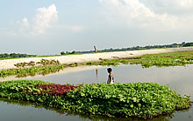
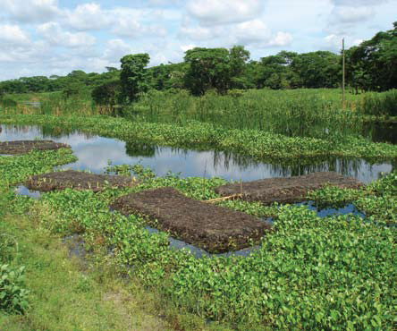
Floating gardens
Floating gardens provide a place for growing crops protected from flooding (Case 6) - As the land floods, the raft will float up and the vegetables will be safe.
Source: New Agriculture
http://www.new-ag.info/focus/focusItem.
php?a=941
Source: CLIMATE CHANGE AND DISPLACEMENT
http://www.fmreview.org/FMRpdfs/FMR31/54-55.pdf

Slide 7
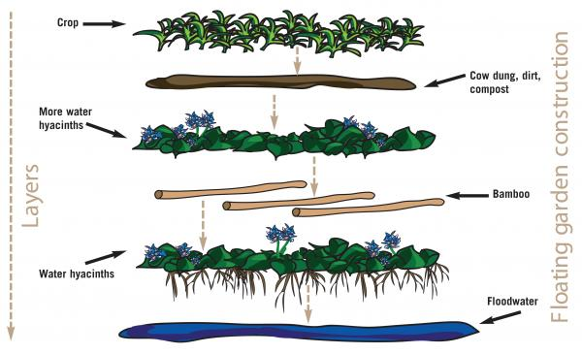

Slide 8
Approach: Climate-Friendly Natural Resource Use
Clean energy technologies and efficient water resource management can be used together to improve agricultural practices, enhance food security, and generate income.
Options
Photo-voltaic water pumping system in Brazil (Case 11) – Aims to improve agricultural productivity in this increasingly drought-prone region through the implementation of a more efficient system of irrigation which uses a solar energy

Slide 9
Approach: Composting; an Adaptation Initiative for Solid Waste Management
By composting organic waste, the amount of solid waste is drastically reduced.
Composting practices can be implemented at the local level and the compost can be sold to generate income.
Options
Adopting eco-friendly composting at the local level to reduce the amount of GHG gas emissions (Case 12) - Pusdakota (University) purchases the compost produced, which enables households to earn an income. Some people scale up their composting activities to increase their income by collecting additional organic waste from other households, gardens, and streets, and by selling seedlings, herbs, and vegetables grown with the compost.

Slide 10
Approach: Innovations in Agriculture Practices
Human migration due to climate change is often caused by climate-change induced floods and droughts, which leaves the soil unproductive for crops.
Options
Pit system of gardening in areas where soil has become unusable - (Case) - Hope for Climate Change Refugees in Bangladesh - Due to recurrent sand casting, the land was unable to support crops - introduced a ‘pit system’ of agriculture on riverbanks - Holes were dug in the sand and filled with compost and mud - Sweet gourds were planted

Slide 11
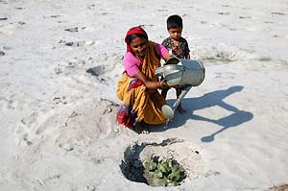
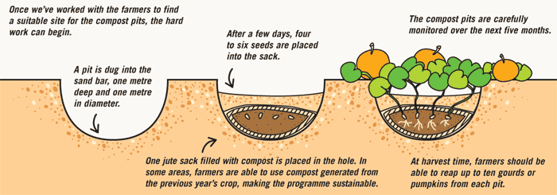

Slide 12
ADAPTING TO CLIMATE CHANGE: BUILD STRONGER INFRASTRUCTURE TO REDUCE RISK

Slide 13
Issue : Adapting to Climate Change: Build Stronger Infrastructure to Reduce Risk
If adaptations are not made or countermeasures not taken, climate change will compromise the functionality of the existing infrastructure

Slide 14
Options
Infrastructure design that considers future flooding (Case 17) - Infrastructure climate-proofing project in Kosrae, Micronesia - Avatiu Harbor - Consideration was given to the impacts of global warming on wave heights - Under current climate conditions, the 50-year wave height is estimated at 10.8 m. Under the climate projected for the year 2060, the 50-year wave height increases to 12.0 m.

Slide 15
STRONG INSTITUTIONAL SUPPORT

Slide 16
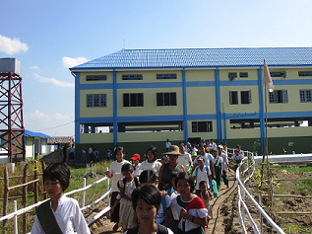
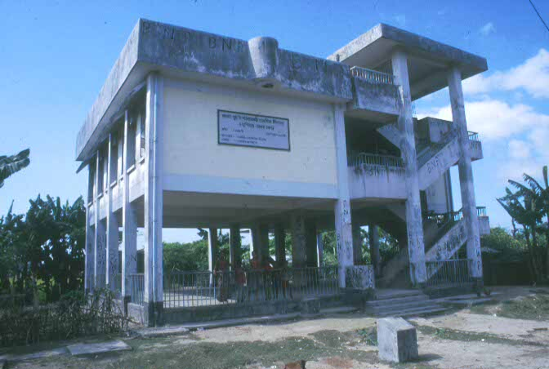
Shelter Maintenance

Slide 17
Approach: Climate-Resilience Through Insurance Services
Options
(Case 26) - Caribbean Catastrophe Risk Insurance Facility (CCRIF) - furnishes short-term liquidity if they suffer catastrophic losses from a hurricane or earthquake - parametric insurance - disburses funds based on the occurrence of a predefined event of a particular intensity, with­out having to wait for onsite loss assessments
(Case 27) Weather-indexed insurance for agriculture in Andhra Pradesh, India - Less susceptible to the problems intrinsic to traditional crop insurance - publicly available weather indicators are the automatic trigger - reduce the insurer's administrative costs

Slide 18
Approach: Risk Reduction Strategies with Respect to Climate Change
Options
Risk reduction though lifestyle adaptation (Case 31) - Saline Water Intrusion Compel Livelihood Shift from Agriculture to alternates in Sundarbans, Bangladesh - promoted new hazard/saline-resilient livelihood strategies for income and food generation, including goat, duck, and hen rearing, chicken and crab farming, tree planting, introduction of salt­water tolerant vegetable gardens, and handicraft production

Slide 19
COMMUNITY-BASED
APPROACHES

Slide 20
Community-Based Approaches
Past experience has shown clearly that villagers are willingly and voluntarily collaborating to develop and apply adaptation measures by contributing their time and resources (Francisco, 2008).
Options
Community-Based Adaptation to Climate Change in Vietnam (Case 34) - The main objective was to help build adaptive strategies to enable communities to deal with recurrent climatic catastrophes - Scenario building, Planning, Project implementation
Case 36: Managing drought through rainwater harvesting initiatives in Gujarat - designed, maintained, and managed by the local communities

Slide 21
Approach: Participatory Community Learning; Climate Field Schools
Behavioral change in response to long-term climate change adaptation can be best achieved through participatory community learning.
A group of farmers undergo a cyclical process of being exposed to an “experience” (actual or simulated) which they observe and reflect upon (analysis), derive lessons from (principles learned), and use as the basis for planning actual applications of such lessons and principles to immediate or future problems.
Options
Case 38 : Indonesia’s Experience with Climate Field Schools (CFS) - translating the information from scientific language into field language - Information regarding the varying dates of onset and termination of rain in different parts of the district is instrumental in setting up a cropping strategy (e.g. dry seeding vs. wet seeding) as well as in determining the timing of planting activities.

Slide 22
CLIMATE CHANGE AND HUMAN HEALTH

Slide 23
Climate Change and Human Health
Direct impacts include those due to changes in exposure to weather extremes (heat waves, winter cold); increases in other extreme weather events (floods, cyclones, storm-surges, droughts); and increased production of air pollutants and aeroallergens (spores and moulds). Additionally - vector-borne infections, the distribution and abundance of vector organisms and intermediate hosts, are affected by various physical factors, such as temperature, precipitation, humidity, surface water, and wind; and biotic factors, such as vegetation, host species, predators, competitors, parasites, and human interventions.
Analyses based on 57,331 admissions over a period of six years at diarrhea clinic in Lima, Peru revealed a 4% increase in admissions for each 1 C increase in temperature

Slide 24
Approach: Climate-Smart Urban and Health Care Design Fostering Synergy Between Mitigation and Adaptation
Options
1. Spain: Strengthening the Existing Health Care System as Part of the Heat Wave Program -The plan has three levels of action during the summer season:
- Level 0 starts on June 1 and focuses on preparedness.
Level 1 is triggered during July and August and focuses on meteorological assessments (including daily recordings of temperature and humidity), disease surveillance, assessment of preventive actions, etc.
Level 2 is activated only if temperature rises above the warning threshold (40 C in inland areas), at which point health and social care and emergency service centers are activated - the centers identify and localize vulnerable populations
2. Climate-smart urban design can foster synergies between mitigation and adaptation - Green spaces - Green-roofing can save energy, attenuate storm water, and provide cooling

Slide 25
IMPLEMENTATION GUIDE

Slide 26
Approach: Take Stock of the Available Information on Hazards Exposure, Vulnerabilities, and Risk Assessment Before Making Intervention Decisions
Experience shows that investments in pre-disaster policy development and planning pays dividends.
Options
Pune City - Anticipating an increased frequency of floods owing to climate change, the city authorities have developed a Integrated Climate Change and Flood Management Plan
Governments should ensure all regulations (e.g. building codes, public health regulations) are also climate-proofed

Slide 27
Approach: Integrating CCA in Development Planning
There is a growing effort to factor adaptation into mainstream planning.
In Benin, a number of municipalities have successfully integrated risk reduction and climate change adaptation into annual development and investment plans (Olhoff, 2011), thereby strengthening technical capacity within municipal governments and establishing a system for climate risk and disaster management.
At the national level, Uganda has begun to integrate climate risk management into a comprehensive development and investment plan.

Slide 28
For more information :
http://www.recoveryplatform.org/assets/Guidance_Notes/INTERNATIONAL_CLIMATECHANGE_220910_without%20Source.pdf

Slide 29

Thank You!

